Slide 1




The Crime Detectives
Natasha Arokium
Jiffar Abakoyas
Bethold Owusu
Thierno Diallo

Slide 2
NYPD arrest data Analysis 2019
New York City has been ranked #25 with the most violent crime rates in the United States. Since we all reside in New York, and safety should be an important aspect of our livelihood, we have embarked on the quest to find out where, who, why, when and what by investigation via Exploratory data analysis, and machine learning techniques which will enable further predictions on which level of arrest is likely to occur based on any number of factors.

Slide 3
Principal features for analysis
Level of Offense
Offense description
Borough of arrest
Precinct where the arrest occurred
Perpetrator’s sex description
Perpetrators' race description
Date of the arrest
Most frequently occurring arrests/locations on the map/month

Slide 4





NYPD made 213,089 arrests in 2019

Slide 5
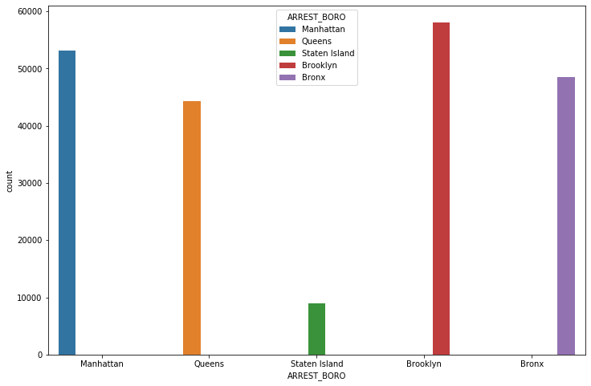
Arrests by Borough
Borough | counts | percent
Brooklyn | 58077 | 27.25%
Manhattan | 53172 | 24.95%
Bronx | 48516 | 22.77%
Queens | 44329 | 20.8%
Staten Island | 8995 | 4.22%
Notes:
Brooklyn recorded the highest number of arrests. Analysis shows that Staten Island is the safest Borough in New York City.

Slide 6
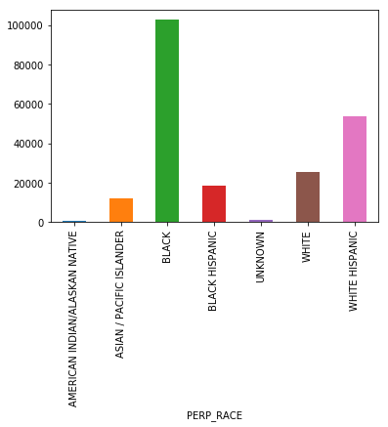
Arrests by Race
Race | counts | percent
BLACK | 101979 | 47.86%
WHITE HISPANIC | 53265 | 25.0%
WHITE | 25284 | 11.87%
BLACK HISPANIC | 18550 | 8.71%
ASIAN / PACIFIC ISLANDER | 12013 | 5.64%
UNKNOWN | 1401 | 0.66%
AMERICAN INDIAN/ALASKAN NATIVE | 597 | 0.28%
Notes:
The Analysis shows that Blacks were arrested more often than any other ethic groups. To get to the bottom of Why, we needed evidence/data that highlights whether it is a case of discrimination. Ironically, currently there lots of discussions surrounding the said topic via social media.

Slide 7
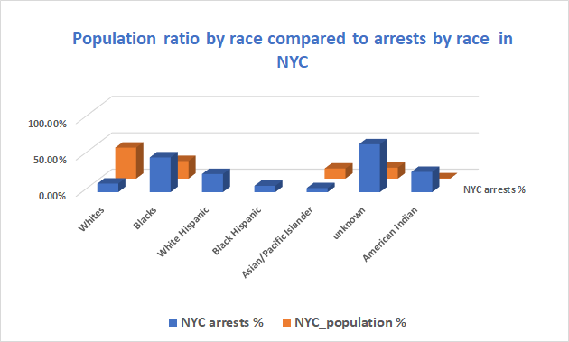
Notes:
According to the most recent ACS, the racial composition of New York City was:
White: 42.67%, Black or African American: 24.27%, Other race: 15.12%, Asian: 13.95%, Two or more races: 3.51%, Native American: 0.43%, Native Hawaiian or Pacific Islander: 0.05% as shown

Slide 8
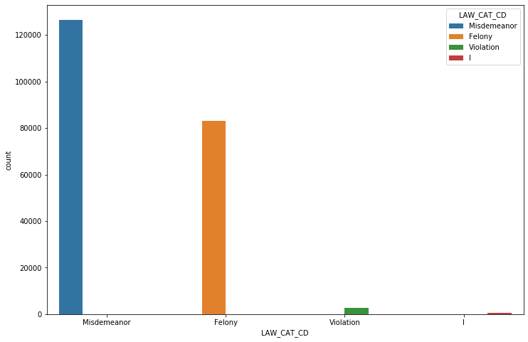
Arrests by Level of Crime
In [30]:
Level Of Arrest | Count | Percent
Misdemeanor | 126590 | 59.41%
Felony | 83244 | 39.07%
Violation | 2822 | 1.32%
I | 433 | 0.2%
Notes:
More of the arrests were for minor offenses(Misdemeanor)

Slide 9
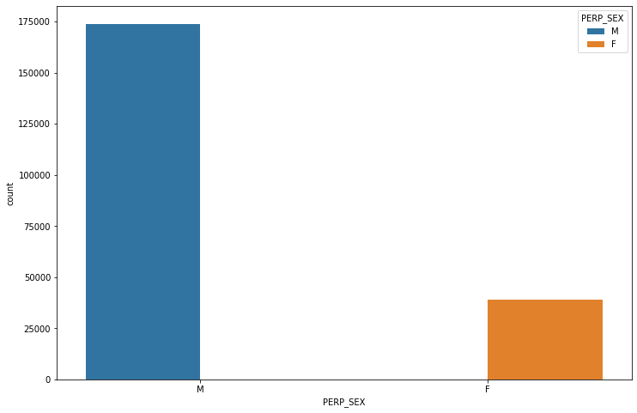
Arrests by Sex
Sex | Count | Percent
M | 173964 | 81.64%
F | 39125 | 18.36%
Notes:
There are approximately 4 times more males arrested than females

Slide 10
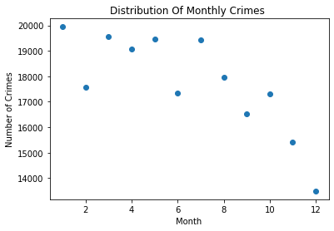
Arrests by month
Notes:
The chart shows a gradual decline in Arrests during the year. With January having the highest arrests, with a high and steady level in March, May, July . December have the lowest Arrests.

Slide 11
Most frequently occurring arrests by description
ARREST DESCRIPTION | COUNTS | PERCENT
ASSAULT 3 & RELATED OFFENSES | 31988 | 15.01%
PETIT LARCENY | 21627 | 10.15%
DANGEROUS DRUGS | 21071 | 9.89%
FELONY ASSAULT | 15208 | 7.14%
VEHICLE AND TRAFFIC LAWS | 14243 | 6.68%
... | ... | ...
HOMICIDE-NEGLIGENT-VEHICLE | 5 | 0.0%
PARKING OFFENSES | 3 | 0.0%
NYS LAWS-UNCLASSIFIED VIOLATION | 2 | 0.0%
LOITERING FOR DRUG PURPOSES | 2 | 0.0%
UNLAWFUL POSS. WEAP. ON SCHOOL | 1 | 0.0%
Notes:
Assaults 3 & related offenses to the list of most frequently occurring arrests by description

Slide 12
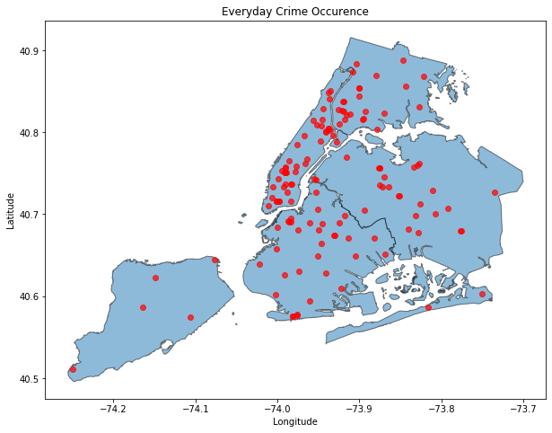
Algorithm to see where crimes occur daily
ALBEE square (BK)
Queens boulevard expressway
Rockefeller center
FULTON MALL (BK)
Gateway dr
Nostrand subway station
Jfk airport
Trans Manhattan exp
Bartow ave (coop city mall)

Slide 13
TOP Arrest description by MONTH
1 - CONTROLLED SUBSTANCE,INTENT TOBURGLARY,UNCLASS...
2 - ASSAULT 2,1,UNCLASSIFIEDPUBLIC ADMINISTATION,U...
3 - FORGERY,ETC.,UNCLASSIFIED-FELOCONTROLLED SUBST...
4 - ROBBERY,OPEN AREA UNCLASSIFIEDCRIMINAL MIS 2 &...
5 - CRIMINAL CONTEMPT 1ASSAULT 3CRIMINAL CONTEMPT ...
6 - CONTROLLED SUBSTANCE, POSSESSIROBBERY,OPEN ARE...
7 - ROBBERY,OPEN AREA UNCLASSIFIEDTRAFFIC,UNCLASSI...
8 - ASSAULT 2,1,UNCLASSIFIEDCONTROLLED SUBSTANCE, ...
9 - CRIMINAL MISCHIEF,UNCLASSIFIED 4NY STATE LAWS,...
10 - ASSAULT 3TRESPASS 3, CRIMINALNY STATE LAWS,UNC...
11 - LARCENY,PETIT FROM OPEN AREAS,INTOXICATED DRIV...
12 - IMPAIRED DRIVING,DRUGFRAUD,UNCLASSIFIED-FELONY...
Notes:
Most frequently occurring arrest description from January to December

